Slide 1

CS 500: Welcome and Orientation
Original slides by Mariana Silva
adapted by Geoffrey Herman for CS 500
Our Vision
Students should have access to quality education from anywhere in the world.
Instructors should have a platform that enables unlimited creativity to deliver that education.

Slide 2
Introductions
Go to us.prairielearn.com and enroll in CS 500
Name
What opportunities do you hope grad school will open to you?
Why are you interested in taking this course?

Slide 3
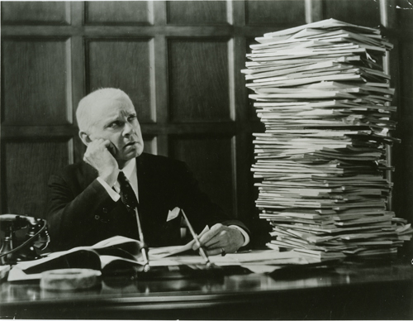

Why Computer-Based Testing?
Departments are struggling with enrollment pressure and exam integrity
Burdens of paper-and-pencil testing:
Authoring:
Exams need to be rewritten every term
Grading:
Grading is time consuming
Students get delayed feedback
Logistics:
Reserve classroom with alternate seating
Arrange proctors
Schedule conflict/make-up exams
We need solutions that provide testing at scale without sacrificing quality!

Slide 4
Benefits from Computer-Based Assessments using Autograders
Improve Learning
Autograding allows for rapid feedback to students
Facilitates adoption of frequent and/or second-chance exams
Facilitate Teaching
Reduces grading load
Allows course staff to spend time on other activities that cannot be automated

Slide 5
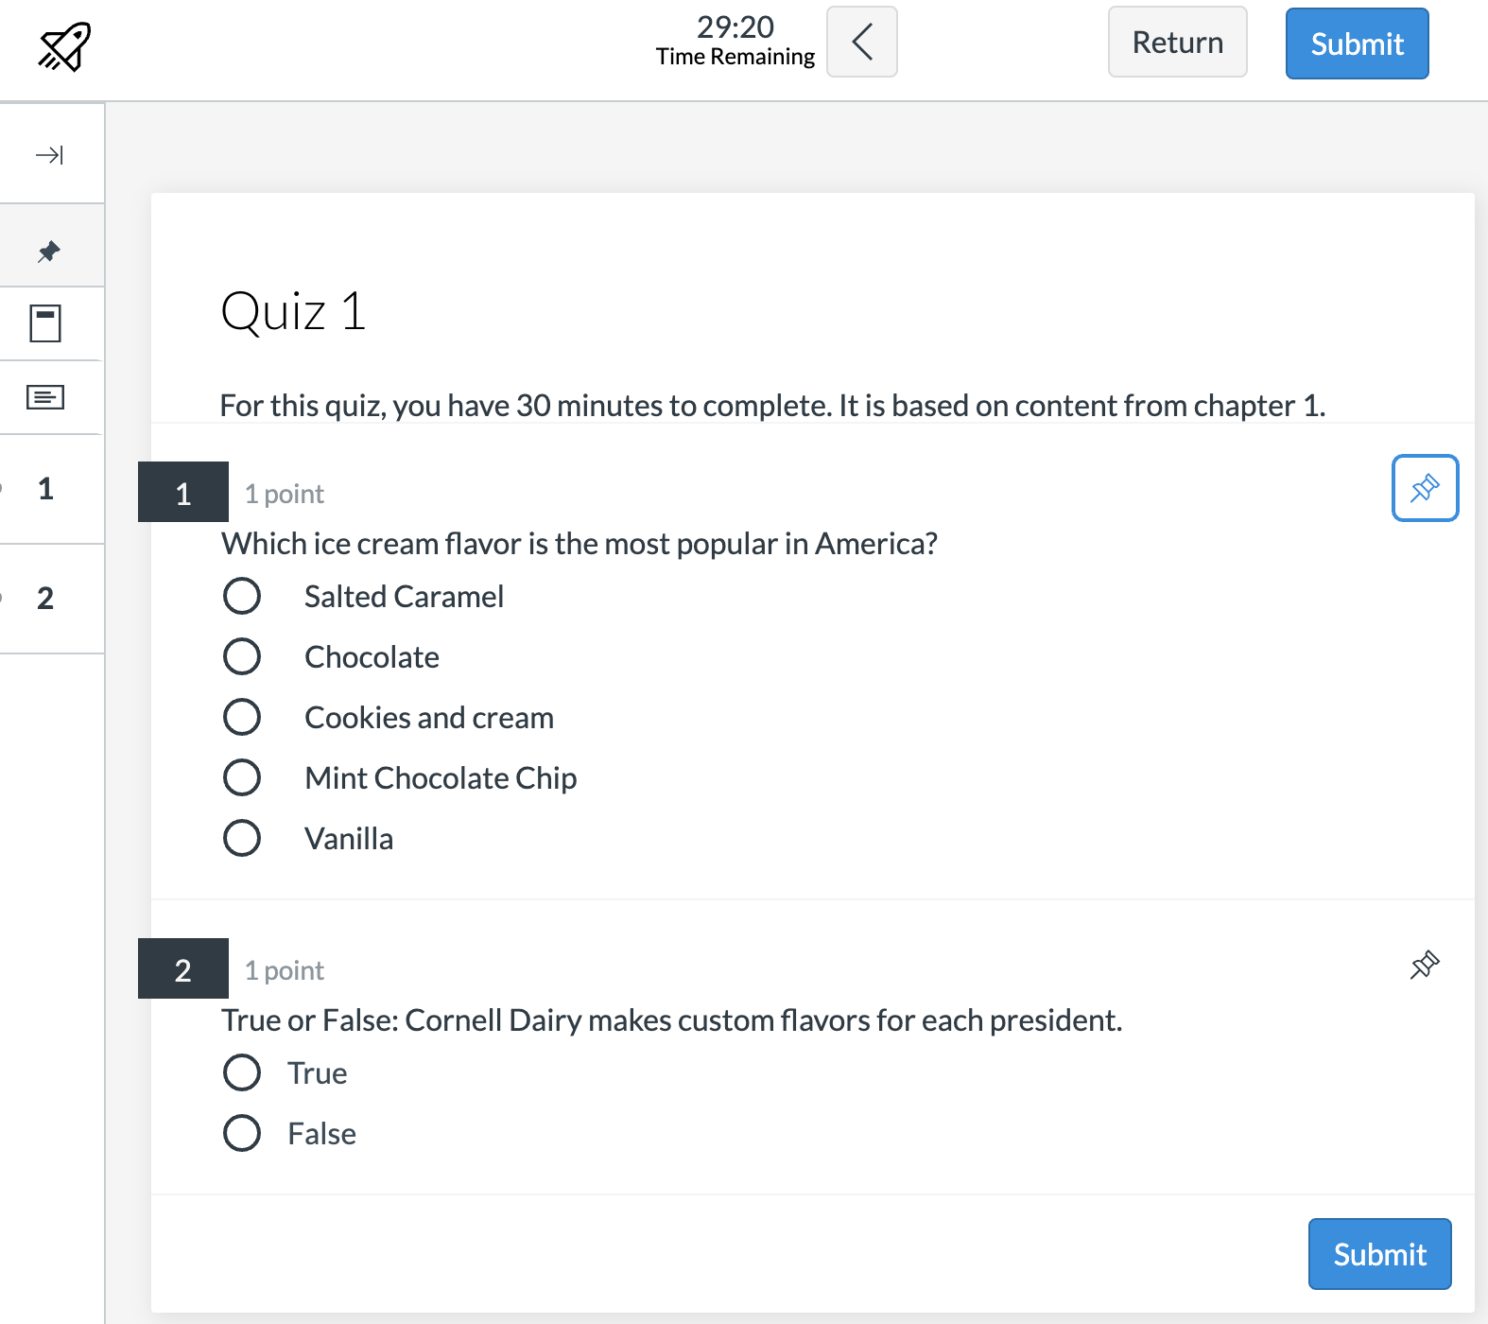


Typical concerns regarding computer-based exams
“Popular” online platforms have limited question types that can be auto-graded, such as multiple-choice and fill-in-the-blank.
Questions are “leaked” the minute the assessment is released. TOO MUCH CHEATING!
Unique questions need to be created for each assessment to ensure integrity of the exam.
But we have a solution!

Slide 6
Our Solution: PrairieLearn + PrairieTest
PrairieLearn: supports better authoring and grading experiences
Authentic and sophisticated questions (auto-graded with instant feedback)
Ability to create question generators (write a question once, and use it many times)
PrairieTest: supports logistics of large-scale exams at testing centers
Secure asynchronous exams to help scaling to large number of students
Centralize/professionalize proctoring

Slide 7
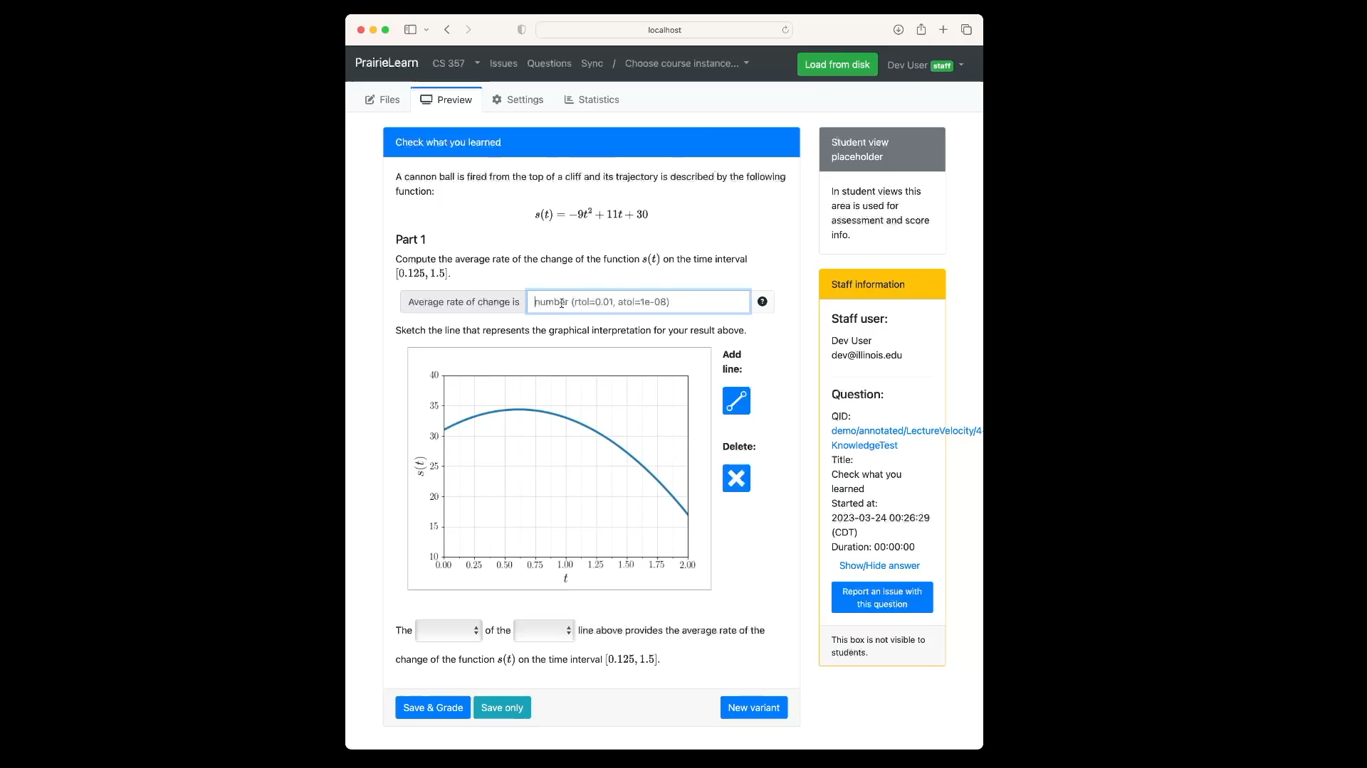
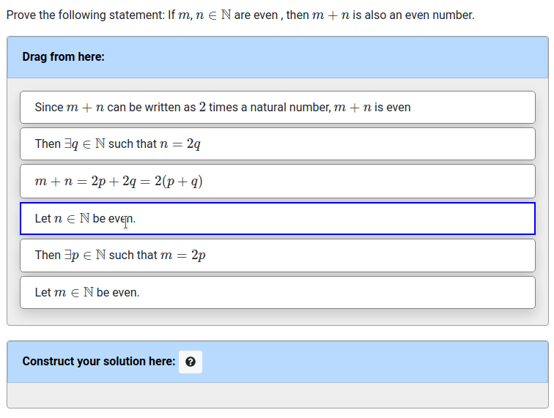
PrairieLearn: Sophisticated Questions
Do not want to dumb things down
Want complex and authentic questions that are auto-graded with quick feedback
Notes:
We want to create sophisticated questions, without dumbing down how students learn, and how we assess their learning. Here we have one examples that uses drag-and-drop of blocks to create and autograde mathematical proofs. The second example generates randomized trajectories s(t) and corresponding plot, and students need to complete a series of questions using numerical input, dropdown menu, and graphical representation of the secant curve.

Slide 8
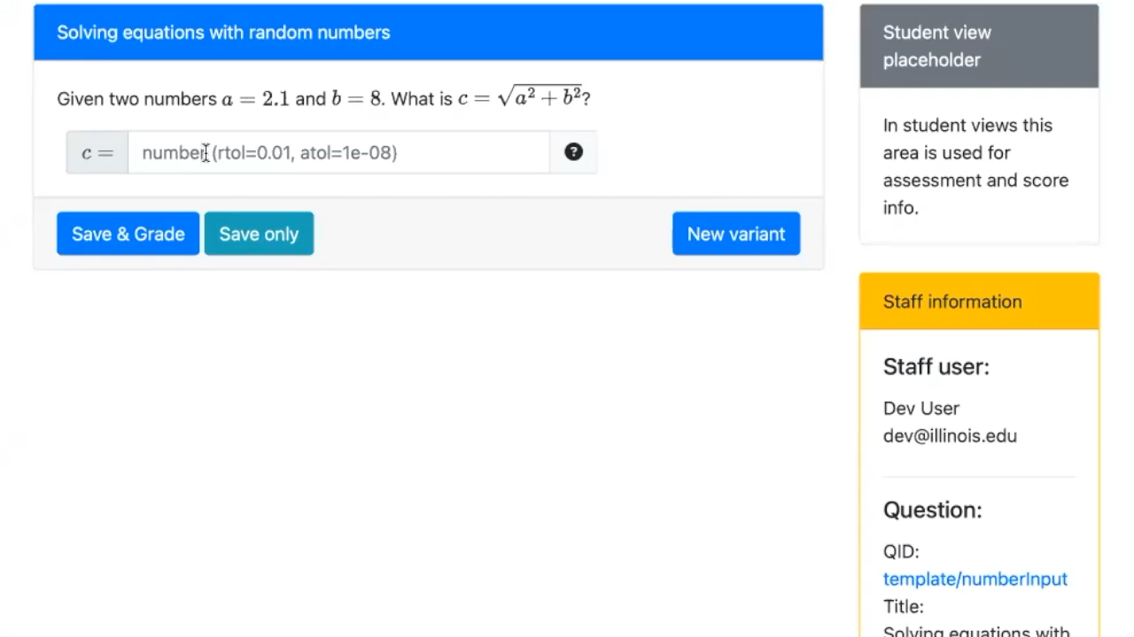
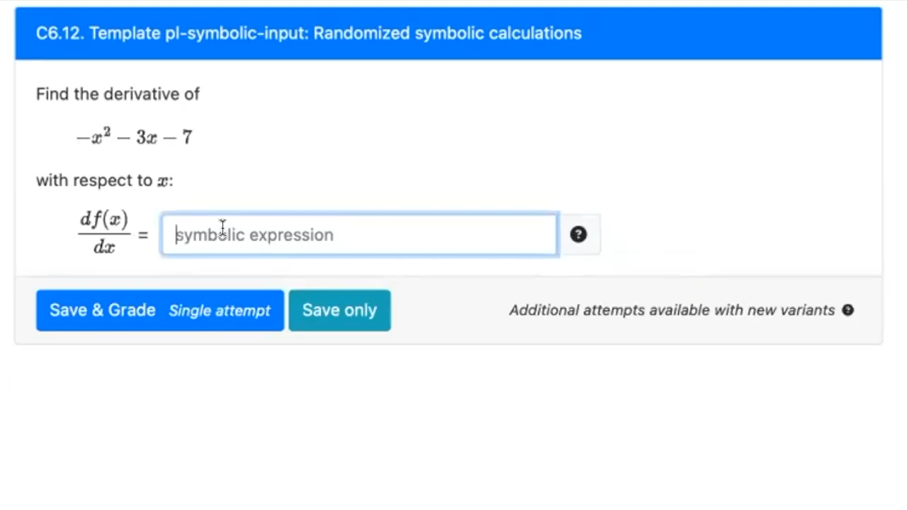
PrairieLearn: Question Generators
Generators create many versions of the question
Enables re-use (homework, exams, across terms)
Students can practice on different variants
server.py
Notes:
One of the key aspects of PrairieLearn is that it let you create question generators, instead of a static version of a question. In this way, students can practice different variants of the same question until mastery is achieved. The autograding and immediate feedback features allow students to work at their own pace. This first example shows how PrairieLearn can autograde symbolic expressions that are not hard-coded string expressions. In that case, both 20*x or 5*4*x are evaluated as the same thing.

Slide 9
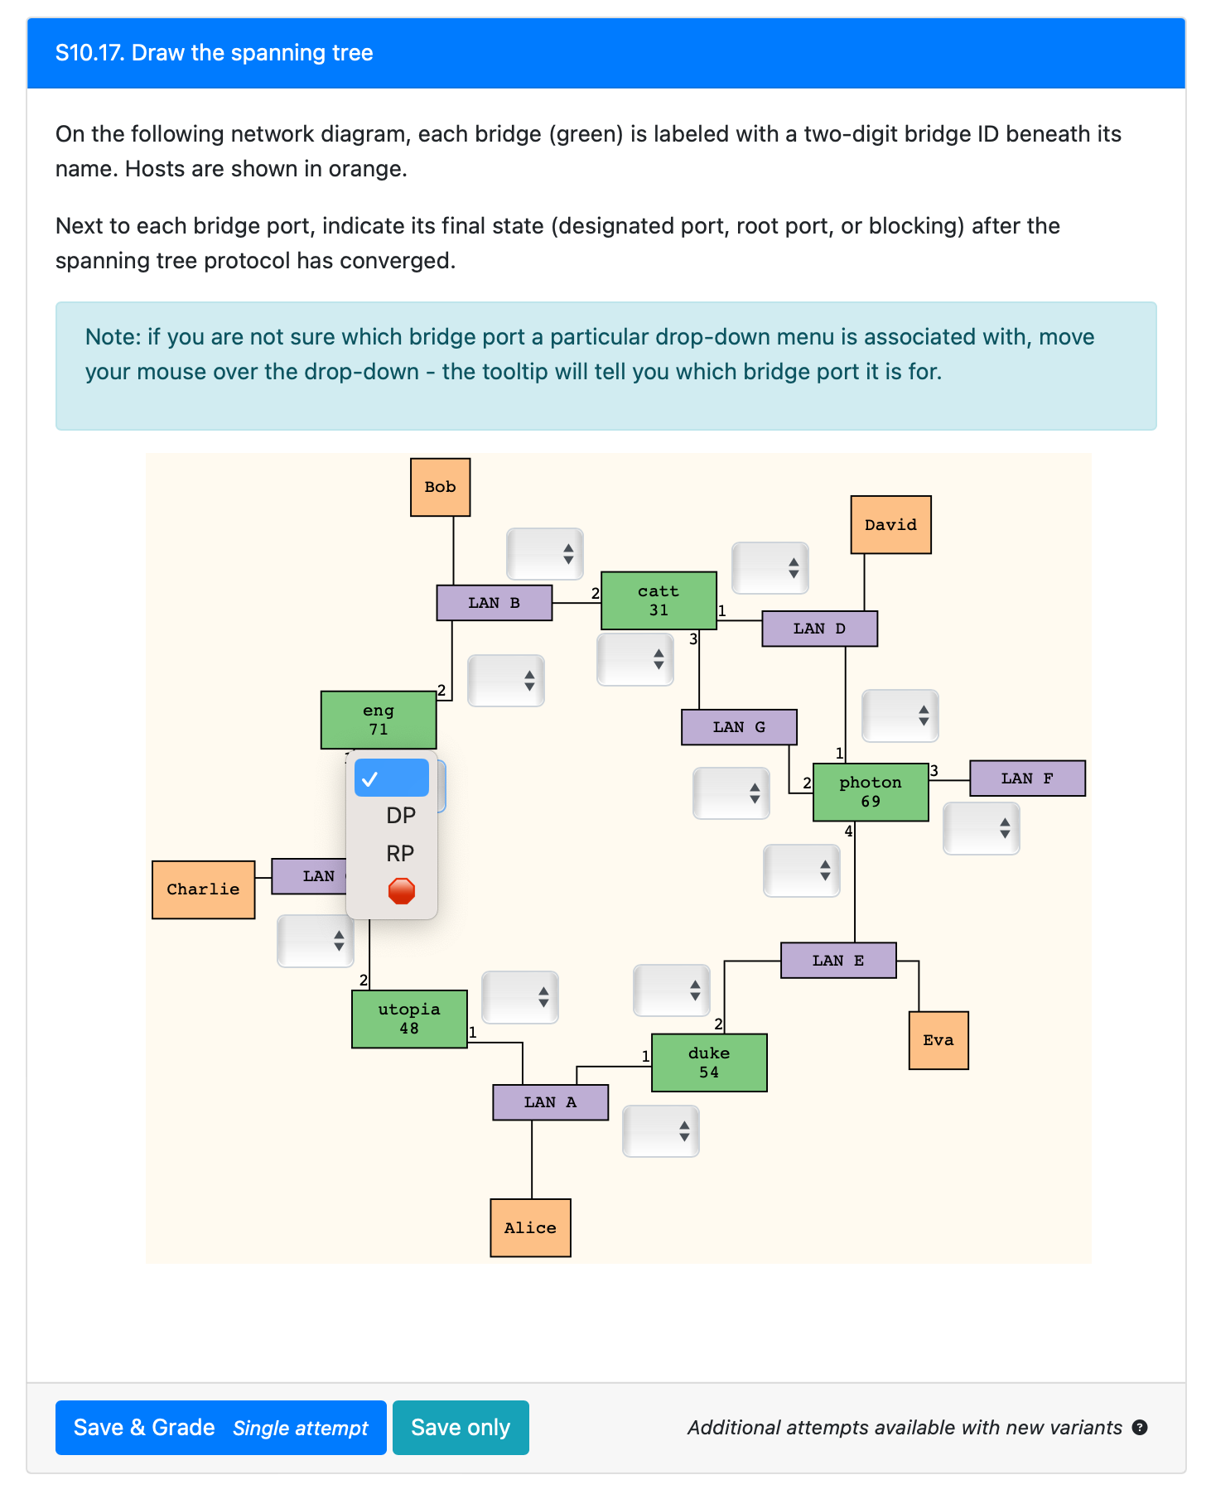
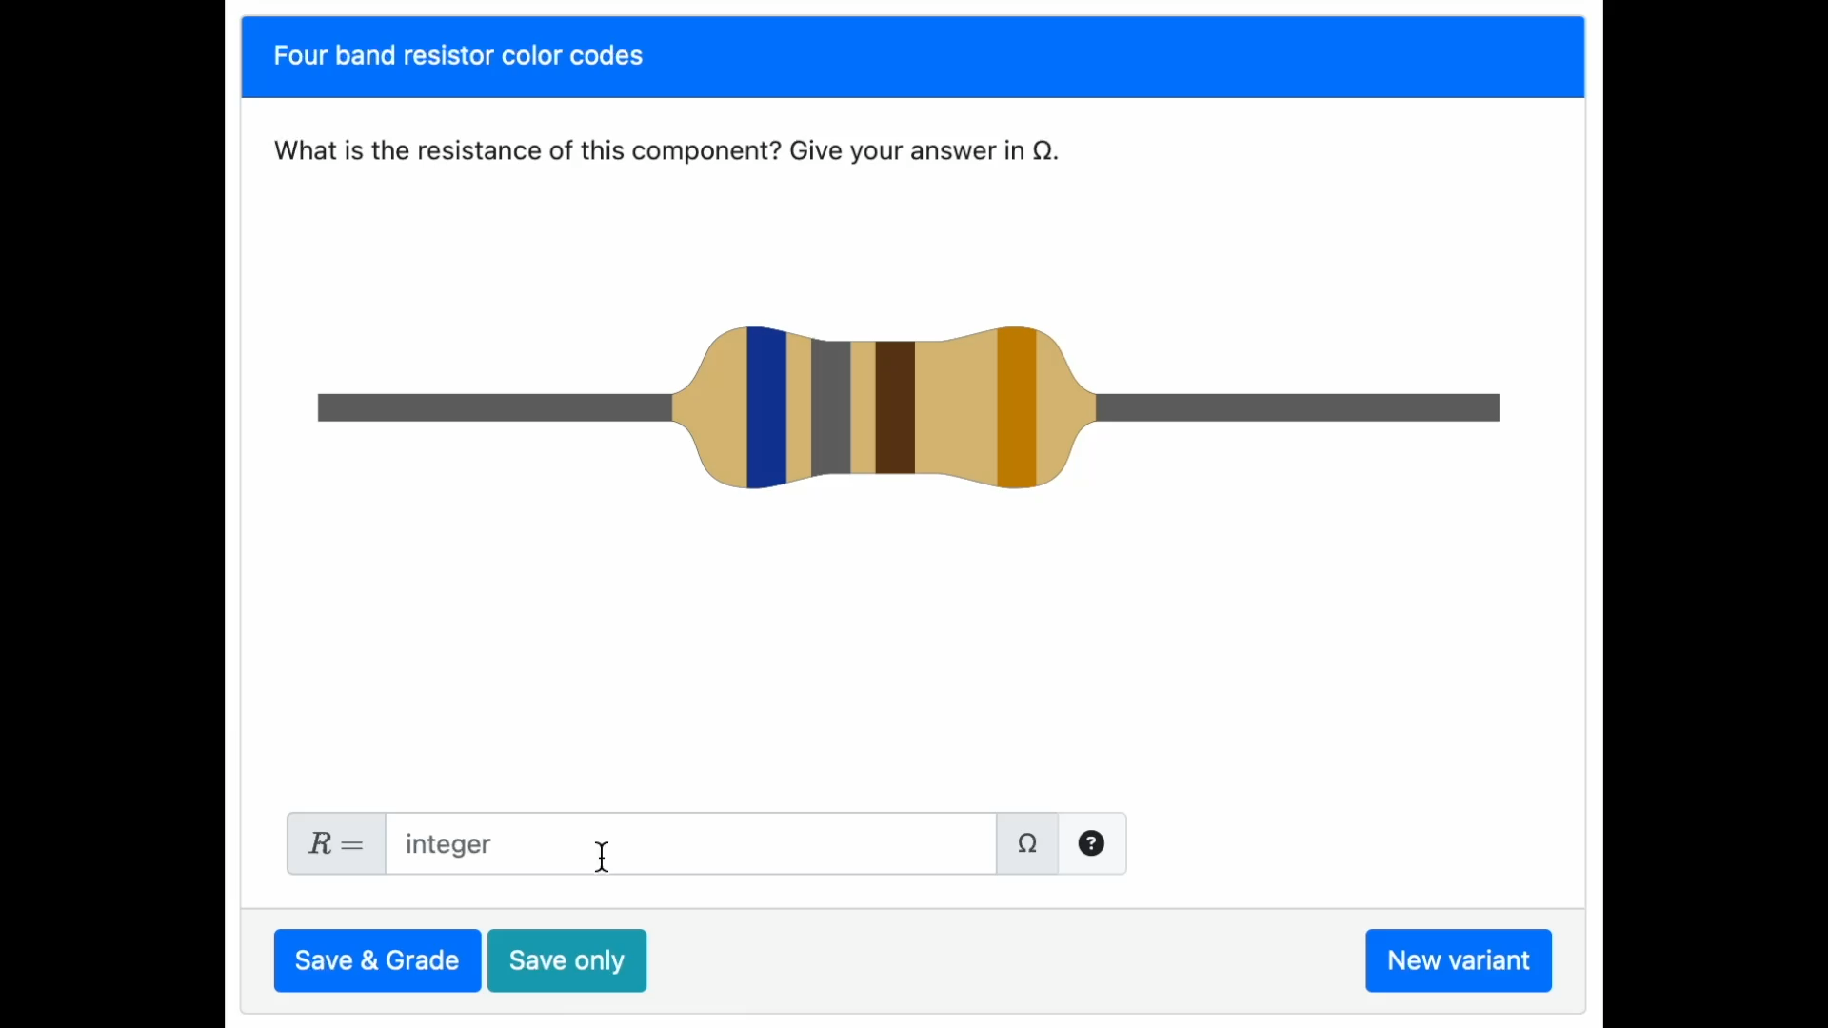
Is there a question you’ve wanted to include in a computer-based assignment but couldn’t due to limitations of other platforms?
If a question can be coded for the web, you can create it in PrairieLearn!

Slide 10
PrairieLearn Questions

Slide 11
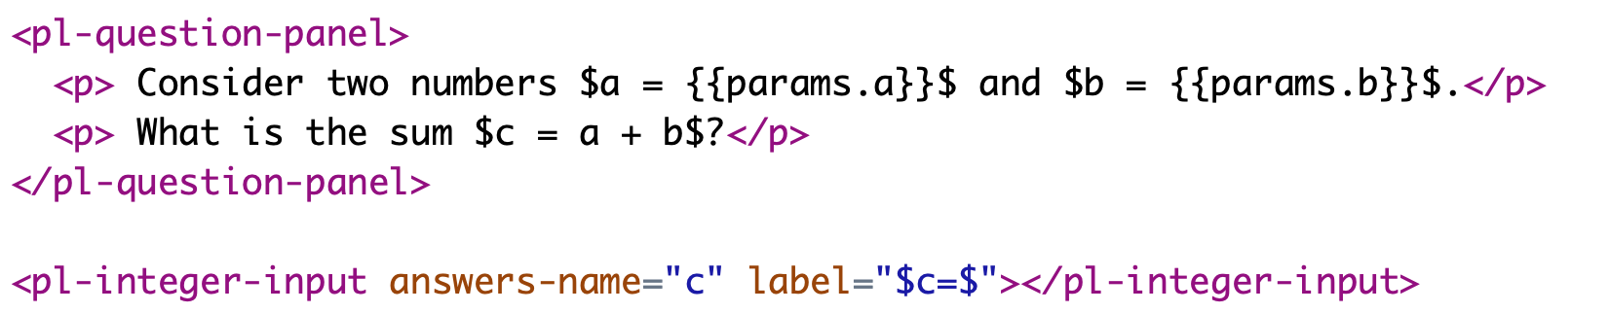
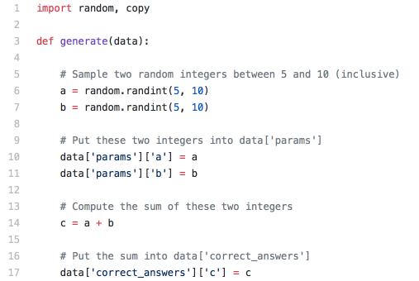
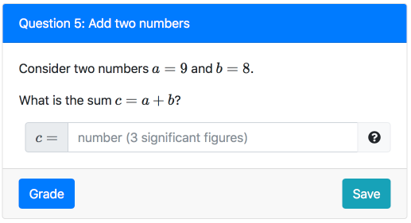
Simple question generator: add numbers
question.html
server.py
Student view
Try this question!
Try another more randomized version

Slide 12
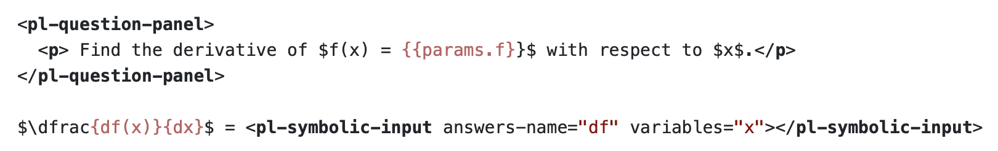
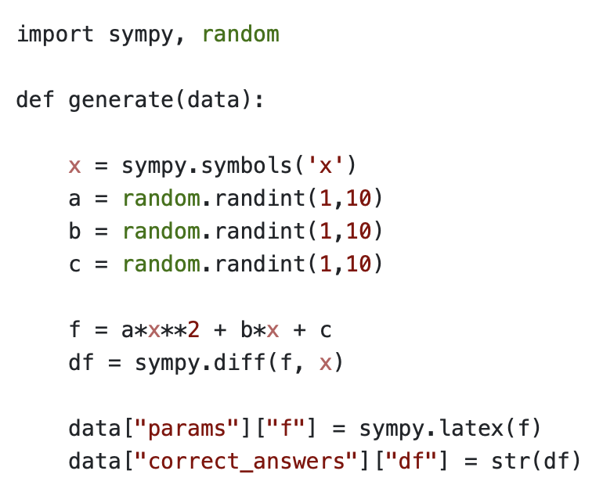
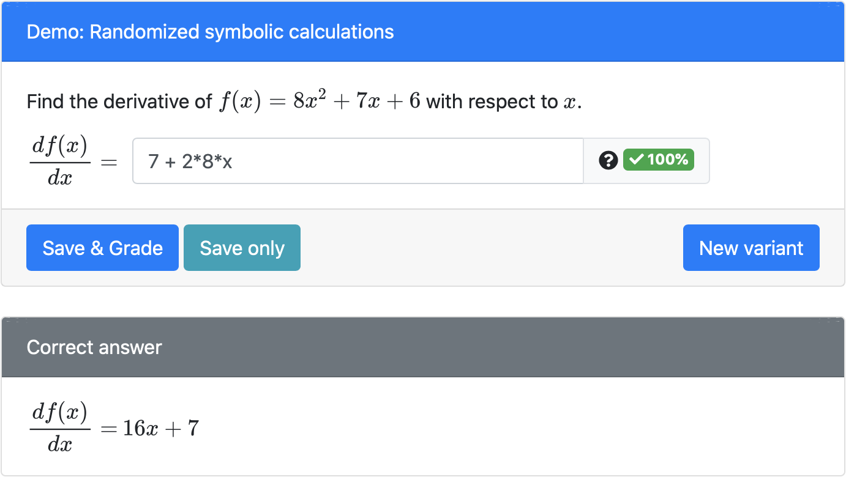
Another example: compare symbolic expressions
question.html
server.py
Student view
Symbolic comparison for grading
12

Slide 13

Browse through our list of PrairieLearn Elements
PrairieLearn element: A reusable package of HTML, Python, and JavaScript
prepare()
render()
parse()
grade()
https://prairielearn.readthedocs.io/en/latest/elements/

Slide 14
To Do
Due 8/29
Read PL SPLICE paper and write reading reaction
Get on PL slack
Complete local install of PL
Modify a PL question on a branch of the course repo
Read a Mustache Tutorial or two
Due 9/3 – Send to instructors on Slack via DM
Personal Learning Goals Statement
IRB Training

